Slide 1






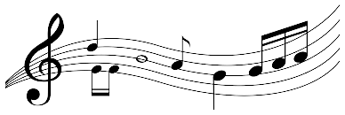

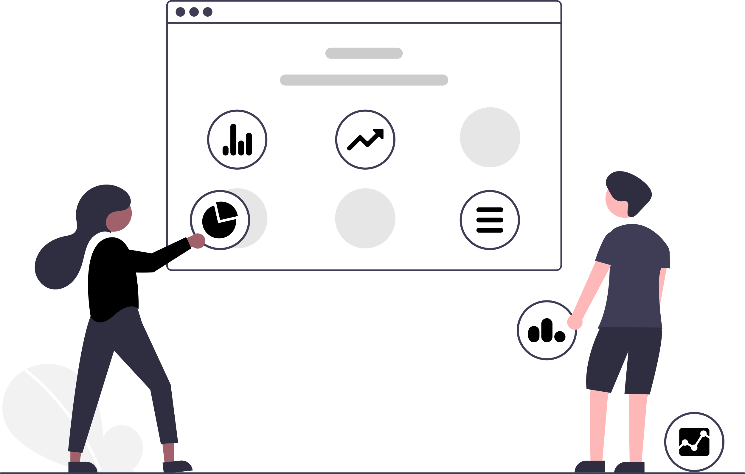


Beating the market, with BeatScout
Advait Bharat Deshpande
Foo Shi Jian
Ho Hui Yu
Neha Bhagat
Ng Wee Kiat
U2122619C
U2110071E
U2110926J
U2110235D
U2122504J
With our thanks to:

Slide 2






UMG has been a dominant force in the music industry
32%
UMG rules as the current market leader, and boasts a star-studded roster of artists
Sources: Trapital, Statista
Hui Yu

Slide 3
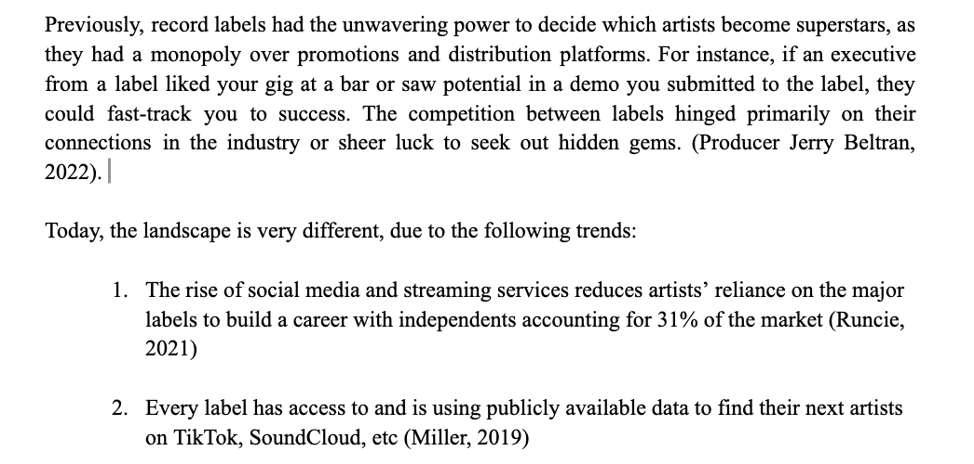


Issue 1: Streaming and social media have disrupted the traditional artist acquisition process
Record labels used to decide who could be a superstar
They used to have more control on promotions, and could even fast-track you to virality if they liked your gig at a bar
Source(s): MusicBusinessWorldwide
Hui Yu

Slide 4
Issue 1: Streaming and social media have disrupted the traditional artist acquisition process
Record labels used to decide who could be a superstar
They used to have more control on promotions, and could even fast-track you to virality if they liked your gig at a bar
Having a wide network and being lucky used to be the key elements of success
Source(s): MusicBusinessWorldwide
Hui Yu

Slide 5




Issue 1: Streaming and social media have disrupted the traditional artist acquisition process
Reduced artists reliance on labels to build their career. Independents account for ~30% of the market today
Every label can now find any artist anywhere
With fast-moving trends, labels find it increasingly challenging to identify ‘talent’
Source(s): MusicBusinessWorldwide
Hui Yu

Slide 6
Issue 1: Streaming and social media have disrupted the traditional artist acquisition process
Reduced artists reliance on labels to build their career. Independents account for ~30% of the market today
Every label can now find any artist anywhere
With fast-moving trends, labels find it increasingly challenging to identify ‘talent’
Streaming services and social media have levelled the playing field between labels, making it harder to identify and sign talent
Source(s): MusicBusinessWorldwide
Hui Yu

Slide 7
Issue 1: Streaming and social media have disrupted the traditional artist acquisition process
Reduced artists reliance on labels to build their career. Independents account for ~30% of the market today
This leaves labels with two options, play the numbers game, or adapt your strategy
Every label can now find any artist anywhere
With fast-moving trends, labels find it increasingly challenging to identify ‘talent’
Streaming services and social media have levelled the playing field between labels, making it harder to identify and sign talent
Hui Yu

Slide 8


UMG’s competitors have begun to adapt their strategies
# Diversification of Revenue
WMG is reducing their reliance on super stars, and finding alternative ways to reach fans
Ideal State
Sony Music is betting big on indie music, and acquiring indie artists, as well as indie music labels
…so what should UMG do?
Use of Analytics
Source(s): Trapital
Hui Yu

Slide 9
UMG’s competitors have begun to adapt their strategies
# Diversification of Revenue
WMG is reducing their reliance on super stars, and finding alternative ways to reach fans
Ideal State
Sony Music is betting big on indie music, and acquiring indie artists, as well as indie music labels
…so what should UMG do?
Use of Analytics
To protect their market position and secure future growth, UMG must make a strategic change
Source(s): Trapital
Hui Yu

Slide 10
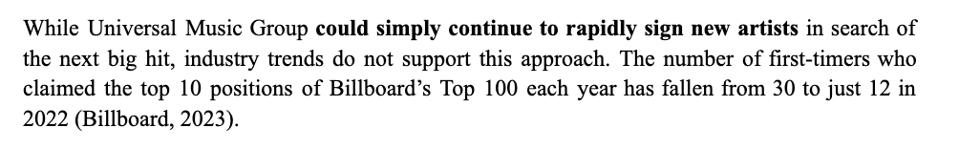
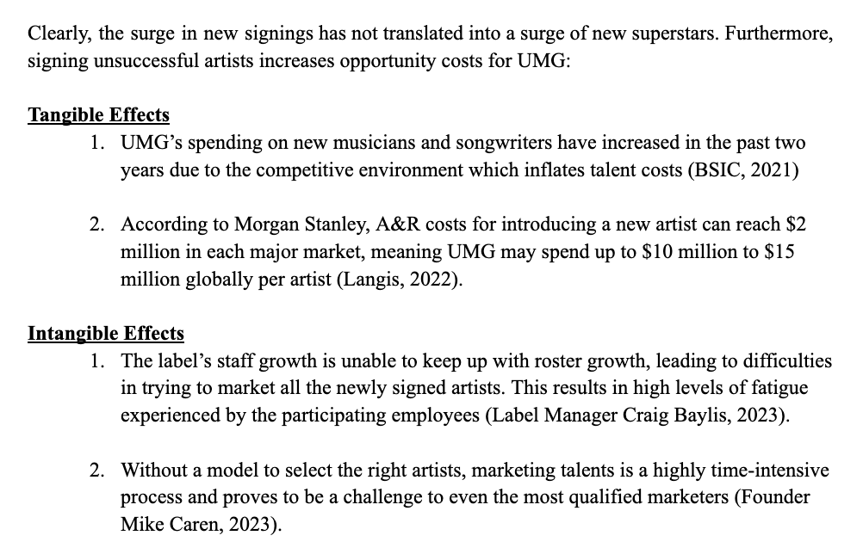


Issue 2: Rapidly signing new artists is resource-intensive and becoming less effective
UMG must make a heavy initial investment for newly signed artists
Talent Costs have been inflated in the past 2 years due to competition
Legend:
Cash Expense
UMGs staff growth cannot keep up with the roster growth, leading to fatigue
Labour Expense
Initial Investment for newly signed artists
Marketing talents is time-intensive and challenging even for experienced marketers
Mentorship
Signing Bonus
Distribution
Marketing
Hui Yu

Slide 11


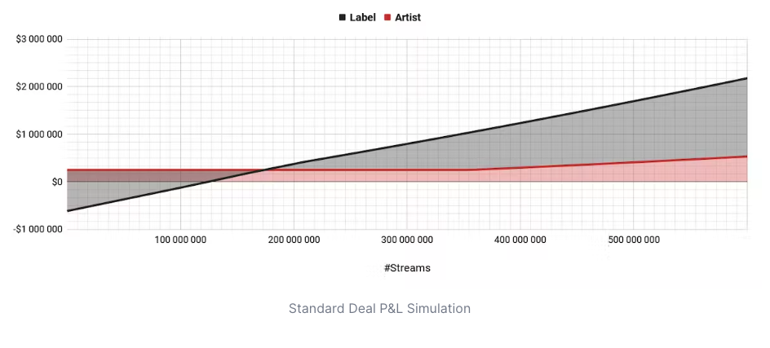

Issue 2: Rapidly signing new artists is resource-intensive and becoming less effective
Current Strategy
A better strategy
Labels must hit a critical number of streams in order to make a profit
Sign 10 Artists without knowing if they are likely to be popular
Sign 8 Artists being at least 50% sure of their success
Only 12
first-timers
top 10 positions in 2022 on Billboard’s Top 100 chart
as compared to 30 in 2021
1 Successful Artist + 9 Average / Underperformers
=
Few Streams
4 Successful Artists + 4 Average / Underperformers
=
More Streams
Hui Yu
Inefficient allocation of labour and money
=
Smaller Profit Margins
Larger Profit Margins
Source(s): MusicBusinessWorldwide, SeekingAlpha, Soundcharts

Slide 12
Issue 2: Rapidly signing new artists is resource-intensive and becoming less effective
Current Strategy
A better strategy
Labels must hit a critical number of streams in order to make a profit
Sign 10 Artists without knowing if they are likely to be popular
Sign 8 Artists being at least 50% sure of their success
Only 12
first-timers
top 10 positions in 2022 on Billboard’s Top 100 chart
as compared to 30 in 2021
1 Successful Artist + 9 Average / Underperformers
=
Few Streams
4 Successful Artists + 4 Average / Underperformers
=
More Streams
It is becoming harder to hit that critical point
Hui Yu
Inefficient allocation of labour and money
=
Smaller Profit Margins
Larger Profit Margins
Source(s): MusicBusinessWorldwide, SeekingAlpha, Soundcharts

Slide 13
Issue 2: Rapidly signing new artists is resource-intensive and becoming less effective
Current Strategy
A better strategy
Labels must hit a critical number of streams in order to make a profit
Sign 10 Artists without knowing if they are likely to be popular
Sign 8 Artists being at least 50% sure of their success
Only 12
first-timers
top 10 positions in 2022 on Billboard’s Top 100 chart
as compared to 30 in 2021
Problem Statement: How can UMG continue its growth in a resource-efficient, and cost-effective way?
1 Successful Artist + 9 Average / Underperformers
=
Few Streams
4 Successful Artists + 4 Average / Underperformers
=
More Streams
It is becoming harder to hit that critical point
Neha
Inefficient allocation of labour and money
=
Smaller Profit Margins
Larger Profit Margins

Slide 14
UMG should introduce analytics into their recruitment process to easily identify future stars
Artist signs up for demo, and submits Spotify Profile
John ends up signing many artists because he does not want to miss a potential superstar
John,
A&R Executive, UMG
Source(s): Billboard
Neha

Slide 15
UMG should introduce analytics into their recruitment process to easily identify future stars
Artist signs up for demo, and submits Spotify Profile
John ends up signing many artists because he does not want to miss a potential superstar
A lot of time and resources get wasted on artists that don’t achieve success
John,
A&R Executive, UMG
Source(s): Billboard
Neha

Slide 16

UMG should introduce analytics into their recruitment process to easily identify future stars
Artist signs up for demo, and submits Spotify Profile
If only John could narrow down his selection to fewer artists with a higher potential
John,
A&R Executive, UMG
Source(s): Billboard
Neha

Slide 17
UMG should introduce analytics into their recruitment process to easily identify future stars
Artist signs up for demo, and submits Spotify Profile
Spotify generates song attributes for all music uploaded to it
Using analytics, UMG can identify artists that produce music with potential to go viral
UMG stands to benefit greatly from being able to improve the accuracy of their artist signings
John,
A&R Executive, UMG
Source(s): Billboard
Neha

Slide 18
UMG is well positioned to explore an analytics solution
UMG can tap on recent partnerships with significant players in the music industry
Collaborate on development of marketing tools and improving music discovery
To help new talent emerge, and explore ambitious experimentation, collaboration and innovation
“Expanded Global Alliance”
Source(s): Variety
Neha

Slide 19



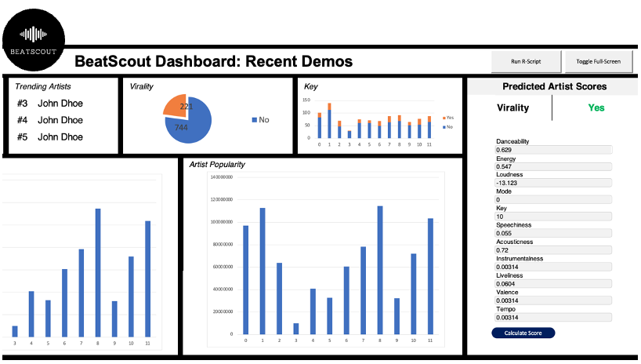


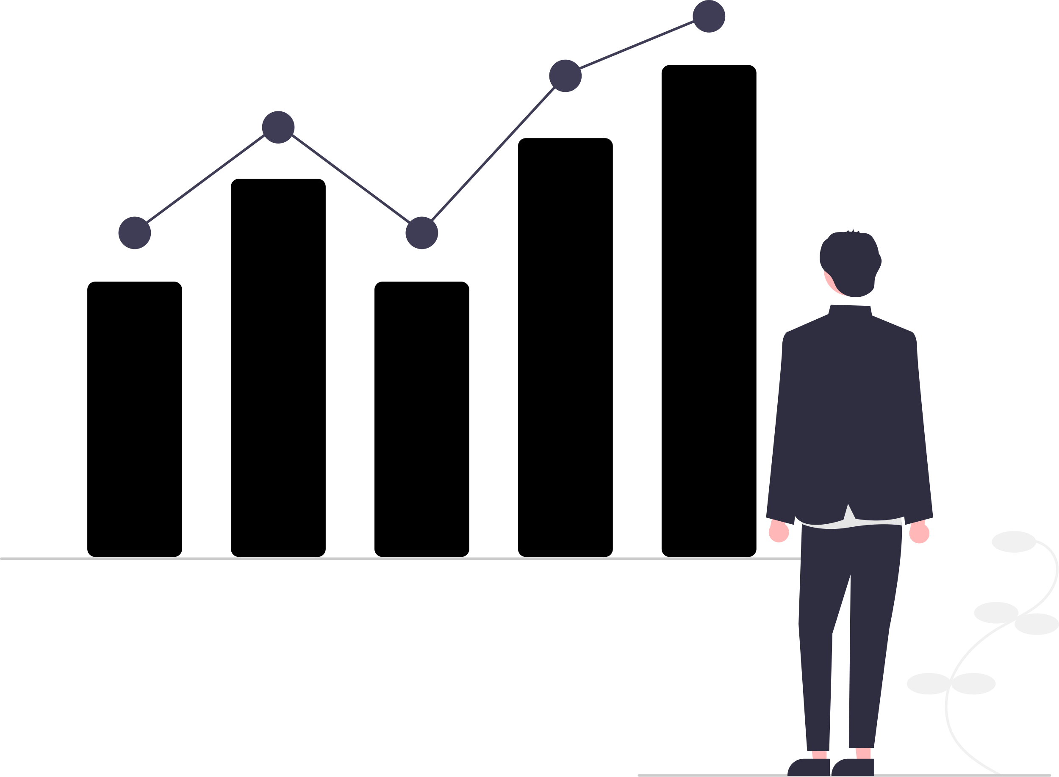
Executive Summary:
Beat the competition with BeatScout
Problems
Model
Product
Business Outcome
Difficult to identify and sign artists with potential
Efficient use of money and labour
Random Forest Model
Higher percentage of superstars
Current strategy of rapidly signing
new artists is
resource-intensive
Recall: 65.2%
Convenient and analytical app for A&R employees
Larger profit margins for UMG
Notes:
With the use of logistic reg model, we have formulated a slew of products that will target both the lack of motivaation from patients and low referral rates from physicians. And with our solution, onBeat, nhcs will be at the forefront, offering comprehensive cardiac care to all your patients. Now I will pass the time to MT to go through the data used to build our model

Slide 20
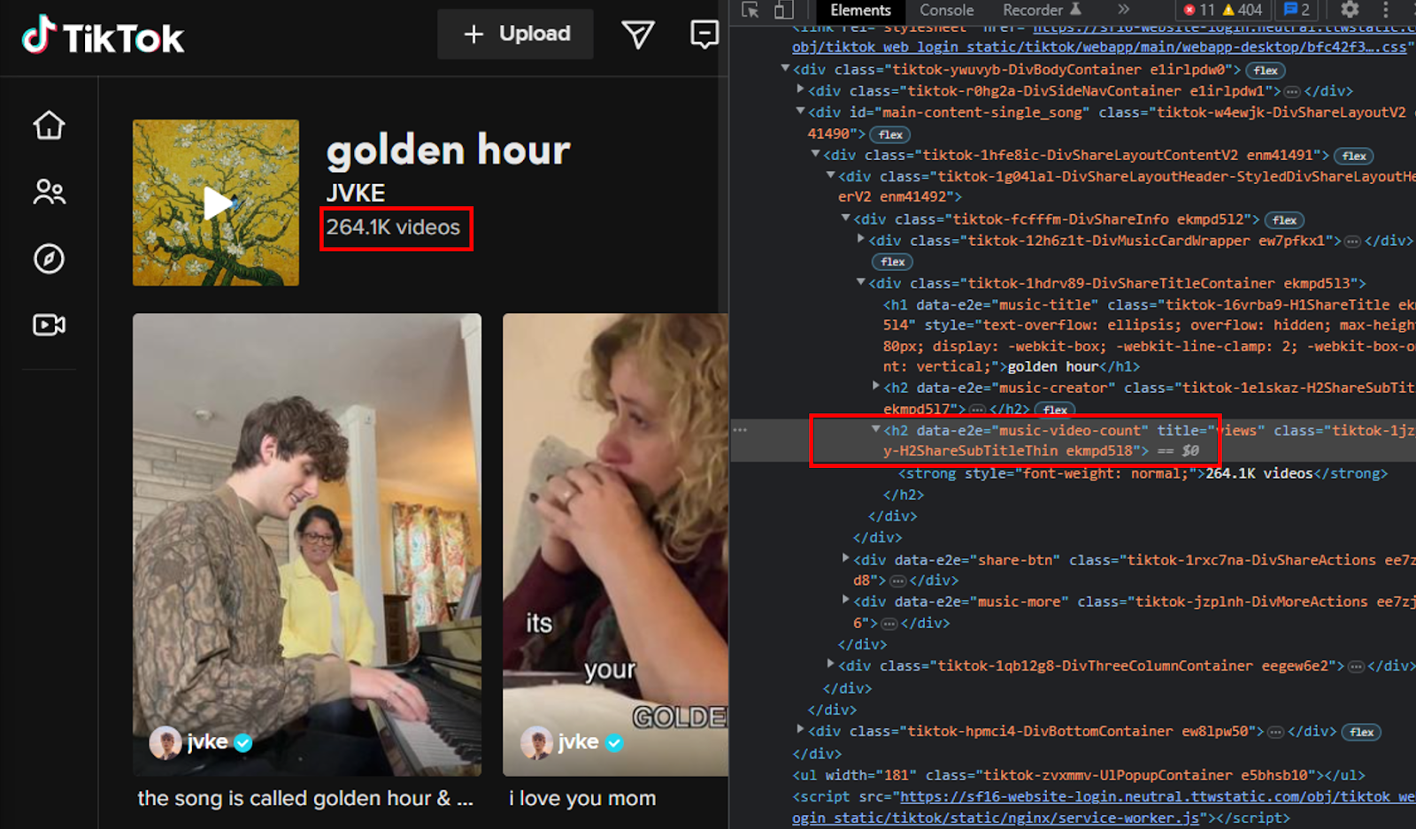
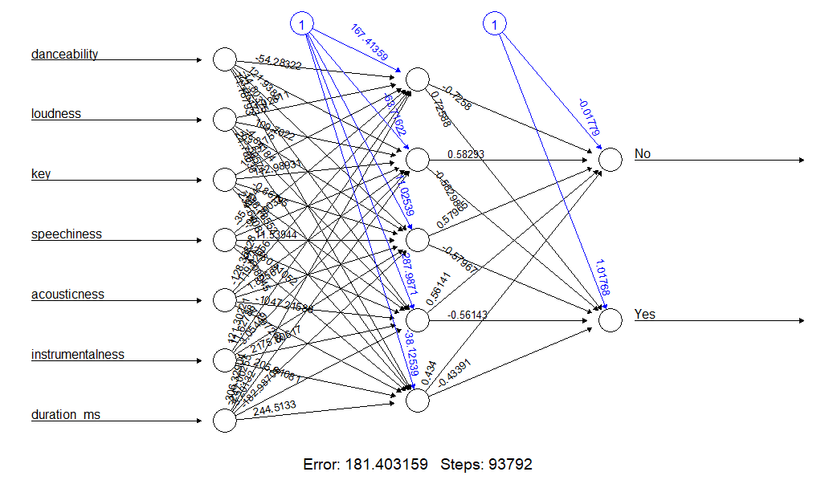
We tackled this issue in 3 Stages to produce an analytical solution
Data Collection, Exploration & Preparation
Data Modelling
Synthesis & Business Implementation
Shi Jian

Slide 21
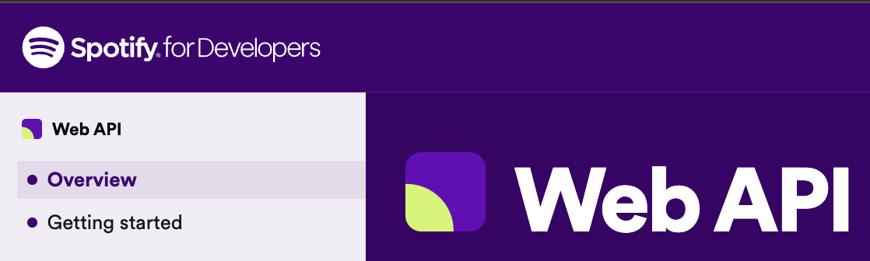

We tackled this issue in 3 Stages to produce an analytical solution
Data Collection, Exploration & Preparation
Data Modelling
Synthesis & Business Implementation
Kaggle dataset
Web-scraping
Sourced from:
For attributes of popular songs on TikTok from 2019 to 2022
For Videos Created on TikTok using a particular song to judge virality
*13 of the 14 No.1 Songs in 2022 were driven by viral trends on TikTok
Source(s): BillBoard, Kaggle, Spotify
Shi Jian

Slide 22
We tackled this issue in 3 Stages to produce an analytical solution
Data Collection, Exploration & Preparation
Data Modelling
Synthesis & Business Implementation
Kaggle dataset
Web-scraping
968 Rows, 24 Columns
Sourced from:
“track_name”, “artist_name”, “Videos_created”,“artist_pop”, “album”, “track_pop”, “danceability”, “energy”, “loudness”, “mode”, “key, “speechiness”, “acousticness”, “instrumentalness”, “liveness”, “valence”, “tempo”, “time_signature”, “duration_ms”, “time_signature.2”, “duration_ms.2”, “time_signature.1” ,“duration_ms.1”
For our Target Variable =
Videos Created on TikTok using a particular song
For attributes of popular songs on TikTok from 2019 to 2022
Shi Jian

Slide 23
We tackled this issue in 3 Stages to produce an analytical solution
Data Collection, Exploration & Preparation
Data Modelling
Synthesis & Business Implementation
Kaggle dataset
Web-scraping
Sourced from:
After cleaning Data & removing irrelevant features,
964 Rows, 14 Columns
For our Target Variable =
Videos Created on TikTok using a particular song
For attributes of popular songs on TikTok from 2019 to 2022
Shi Jian

Slide 24
We tackled this issue in 3 Stages to produce an analytical solution
Data Collection, Exploration & Preparation
Data Modelling
Synthesis & Business Implementation
Viral
“virality” column created
Threshold = Mean
Not Viral
It is important to note that the threshold for what is viral is subjective and can change with time
Shi Jian

Slide 25
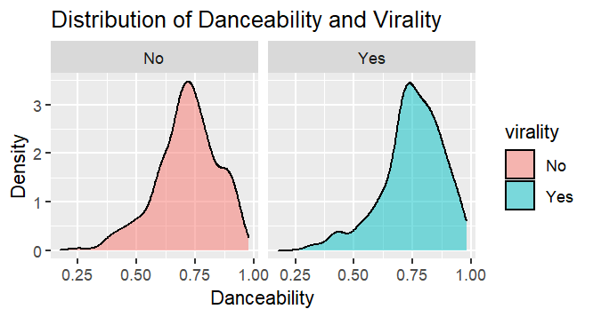
We tackled this issue in 3 Stages to produce an analytical solution
Data Collection, Exploration & Preparation
Data Modelling
Synthesis & Business Implementation
Data Exploration
Contrary to what we would expect, Danceability among both Viral and Non-Viral Songs is distributed similarly
Shi Jian

Slide 26
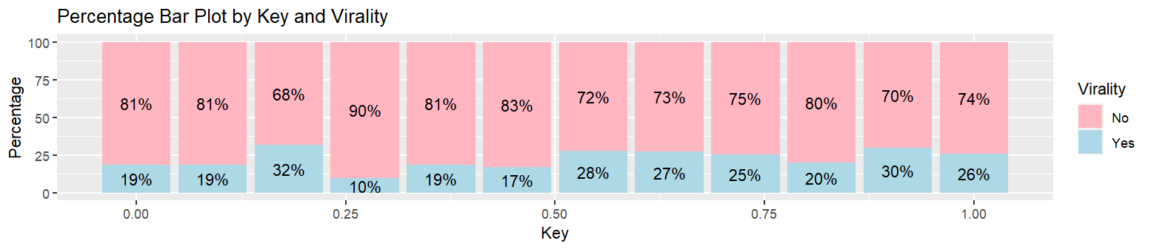
We tackled this issue in 3 Stages to produce an analytical solution
Data Collection, Exploration & Preparation
Data Modelling
Synthesis & Business Implementation
Data Exploration
Songs in the 3rd and 11th key are more likely to go viral
Shi Jian

Slide 27
We tackled this issue in 3 Stages to produce an analytical solution
Data Collection, Exploration & Preparation
Data Modelling
Synthesis & Business Implementation
Data Preparation
Data Scaling
Between
‘0’ and ’1’
Train-Test Split
70/30
Feature Selection
Balancing Trainset
Shi Jian

Slide 28
We tackled this issue in 3 Stages to produce an analytical solution
Data Collection, Exploration & Preparation
Data Modelling
Synthesis & Business Implementation
Data Preparation
Data Scaling
Between
‘0’ and ’1’
Train-Test Split
70/30
Feature Selection
Balancing Trainset
All features were brought to the same scale to improve model accuracy
Shi Jian

Slide 29
We tackled this issue in 3 Stages to produce an analytical solution
Data Collection, Exploration & Preparation
Data Modelling
Synthesis & Business Implementation
Data Preparation
Data Scaling
Between
‘0’ and ’1’
Train-Test Split
70/30
Feature Selection
Balancing Trainset
The data was randomly split into training and testing sets to reduce bias
Shi Jian

Slide 30
We tackled this issue in 3 Stages to produce an analytical solution
Data Collection, Exploration & Preparation
Data Modelling
Synthesis & Business Implementation
Data Preparation
Data Scaling
Between
‘0’ and ’1’
Train-Test Split
70/30
Feature Selection
Balancing Trainset
We used Random Forest and Logistic Regression to perform Feature Selection
Shi Jian

Slide 31


We tackled this issue in 3 Stages to produce an analytical solution
Data Collection, Exploration & Preparation
Data Modelling
Synthesis & Business Implementation
Data Preparation
Feature Selection
Random Forest
– Variable Importance
{ acousticness, danceability, loudness, duration_ms, instrumentalness, key, speechiness}
Logistic Regression
– Backward Elimination using p-value
Saving computational power while retaining accuracy
Shi Jian

Slide 32
We tackled this issue in 3 Stages to produce an analytical solution
Data Collection, Exploration & Preparation
Data Modelling
Synthesis & Business Implementation
Data Preparation
Data Scaling
Between
‘0’ and ’1’
Train-Test Split
70/30
Feature Selection
Balancing Trainset
Due to “Viral” cases being rarer, we balanced the training data with up-sampling to improve model accuracy
Shi Jian

Slide 33
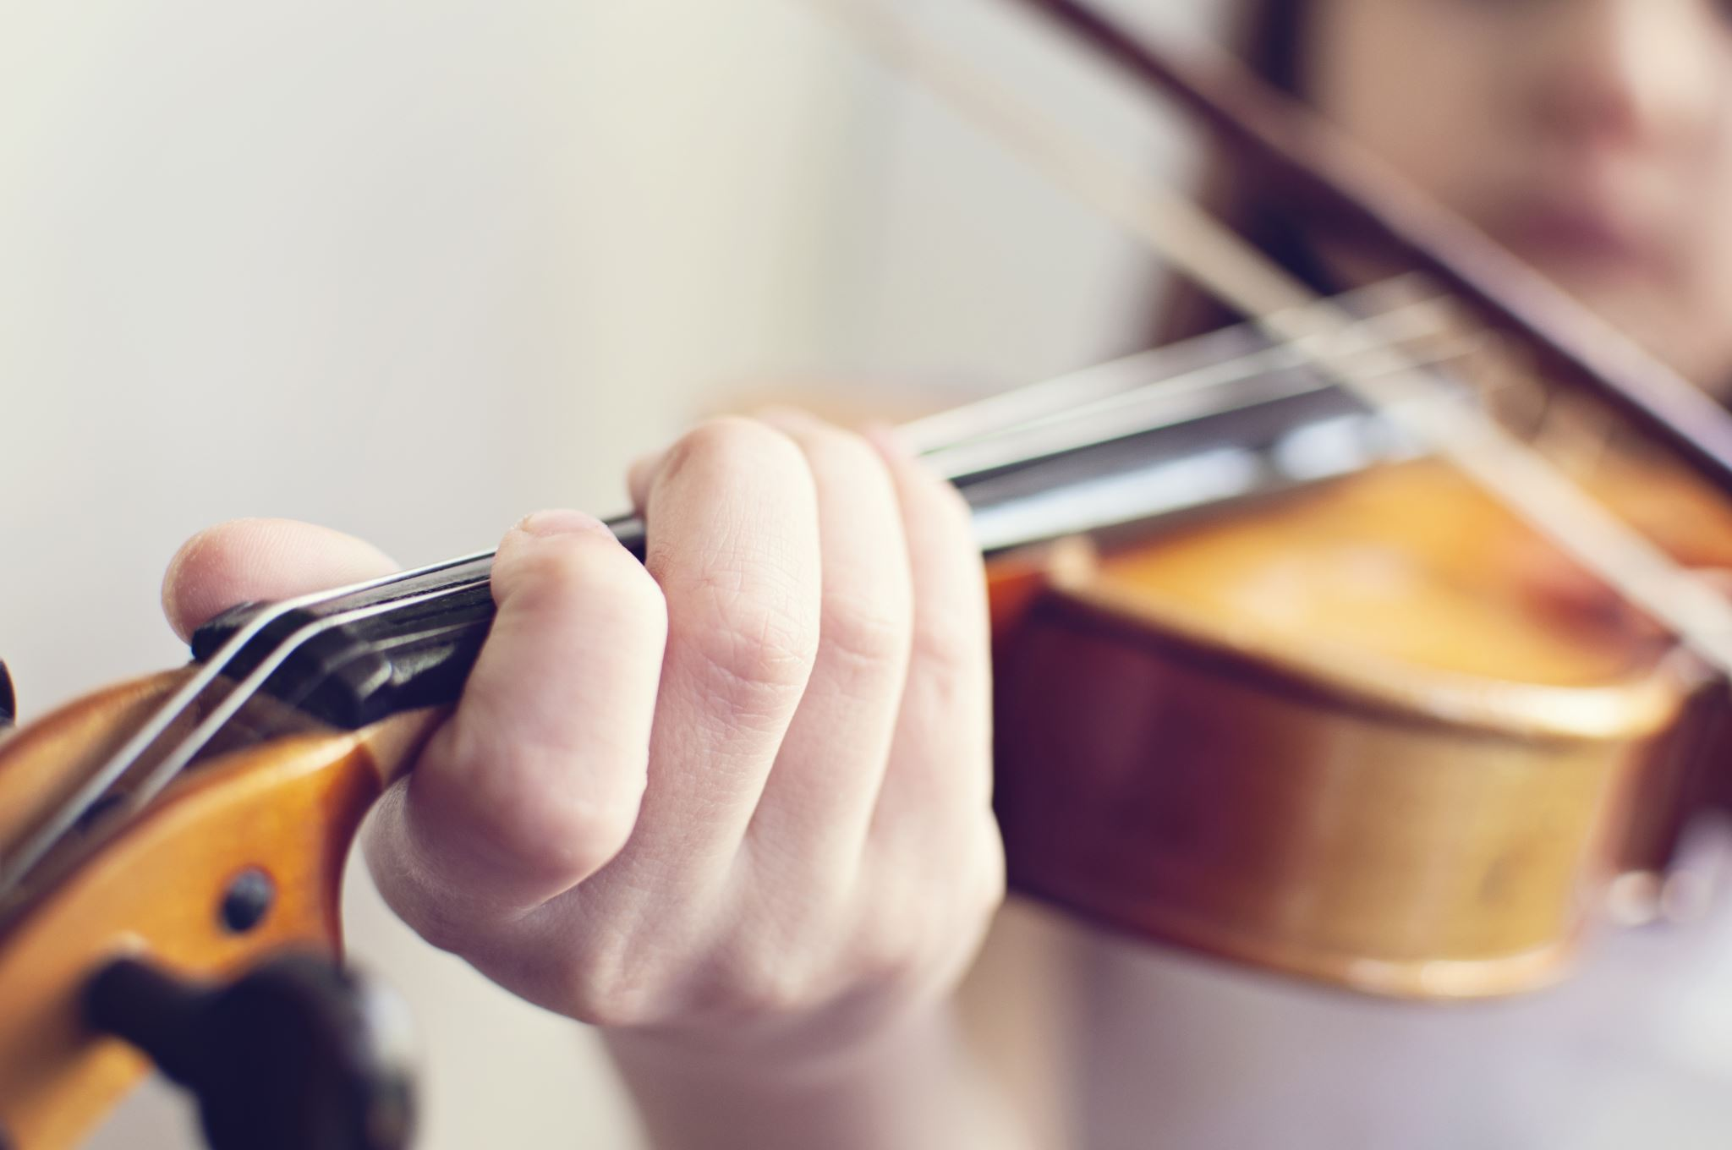

We tackled this issue in 3 Stages to produce an analytical solution
Data Collection, Exploration & Preparation
Data Modelling
Synthesis & Business Implementation
Key Metrics
Accuracy
False Positive Rate
False Negative Rate
High FPR results in resources invested in promoting a track that does not have commercial potential. High FNR will lead to missing out on the signing of a potential star.
Shi Jian

Slide 34



We tackled this issue in 3 Stages to produce an analytical solution
Data Collection, Exploration & Preparation
Data Modelling
Synthesis & Business Implementation
Key Metrics
F1 Score
F1 Gain
In the real world, we are more likely to see highly imbalanced data. There will inevitably be few “Viral” songs, compared to “Not Viral”
Shi Jian

Slide 35
We tackled this issue in 3 Stages to produce an analytical solution
Data Collection, Exploration & Preparation
Data Modelling
Synthesis & Business Implementation
Classification Model | Accuracy | FPR | FNR | F1 Score | F1 Gain
Logistic Regression | 43.9% | 69.1% | 12.1% | 41.7% | 58.7%
CART | 74.0% | 18.4% | 51.5% | 46.0% | 65.3%
Random Forest | 79.6% | 11.2% | 51.5% | 52.0% | 72.7%
MARS | 48.1% | 57.4% | 33.3% | 37.0% | 49.6%
Neural Network | 59.5% | 38.1% | 48.5% | 36.8% | 49.1%
*F1 Gain considers class imbalance while F1 Score does not*
Shi Jian

Slide 36
We tackled this issue in 3 Stages to produce an analytical solution
Data Collection, Exploration & Preparation
Data Modelling
Synthesis & Business Implementation
Classification Model | Accuracy | FPR | FNR | Recall/ TPR | TNR | F1 Score | F1 Gain
Random Forest | 79.6% | 11.2% | 51.5% | 48.5% | 88.8% | 52.0% | 72.7%
Random Forest Tuned | 66.1% | 33.6% | 34.8% | 65.2% | 66.3% | 46.7% | 66.3%
*Improvements came at the expense of Accuracy, F1 Score and F1 Gain*
Shi Jian

Slide 37
We tackled this issue in 3 Stages to produce an analytical solution
Data Collection, Exploration & Preparation
Data Modelling
Synthesis & Business Implementation
Song attributes sourced from the Spotify API
Random Forest Model trained on ~1000 data points will classify song as either Viral or Not Viral
Viral
Virality metrics scraped from TikTok
Not Viral
Advait

Slide 38
We tackled this issue in 3 Stages to produce an analytical solution
Data Collection, Exploration & Preparation
Data Modelling
Synthesis & Business Implementation
Song attributes sourced from the Spotify API
Both sources of data can be accessed live:
From undiscovered artists’ Spotify profiles
Virality metrics scraped from TikTok
From TikTok website
Advait

Slide 39
We tackled this issue in 3 Stages to produce an analytical solution
Data Collection, Exploration & Preparation
Data Modelling
Synthesis & Business Implementation
Song attributes sourced from the Spotify API
Both sources of data can be accessed live:
We can conveniently obtain and process data from songs whose virality we want to predict
From undiscovered artists’ Spotify profiles
Virality metrics scraped from TikTok
Random Forest Model can be kept up-to-date easily
From TikTok website
Advait

Slide 40
We tackled this issue in 3 Stages to produce an analytical solution
Data Collection, Exploration & Preparation
Data Modelling
Synthesis & Business Implementation
Now what if UMG could access this in all from one place?
Song attributes sourced from the Spotify API
Both sources of data can be accessed live:
We can conveniently obtain and process data from songs whose virality we want to predict
From undiscovered artists’ Spotify profiles
Virality metrics scraped from TikTok
Random Forest Model can be kept up-to-date easily
From TikTok website
Advait

Slide 41
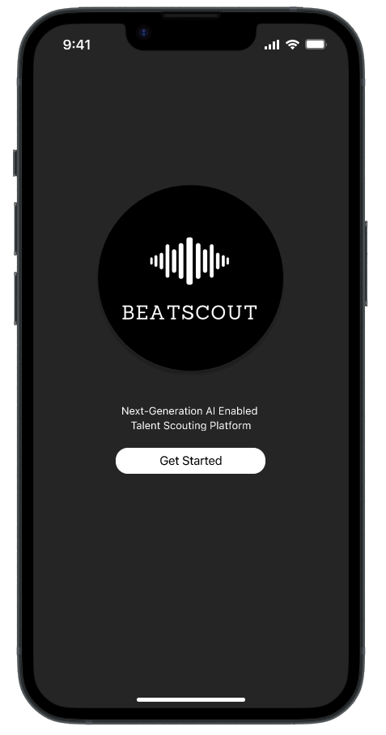



Introducing BeatScout: Helping UMG beat the competition and scout hidden gems in the music industry
BeatScout analyses a songs attributes to predict whether an artist's music can go viral on TikTok
Advait

Slide 42
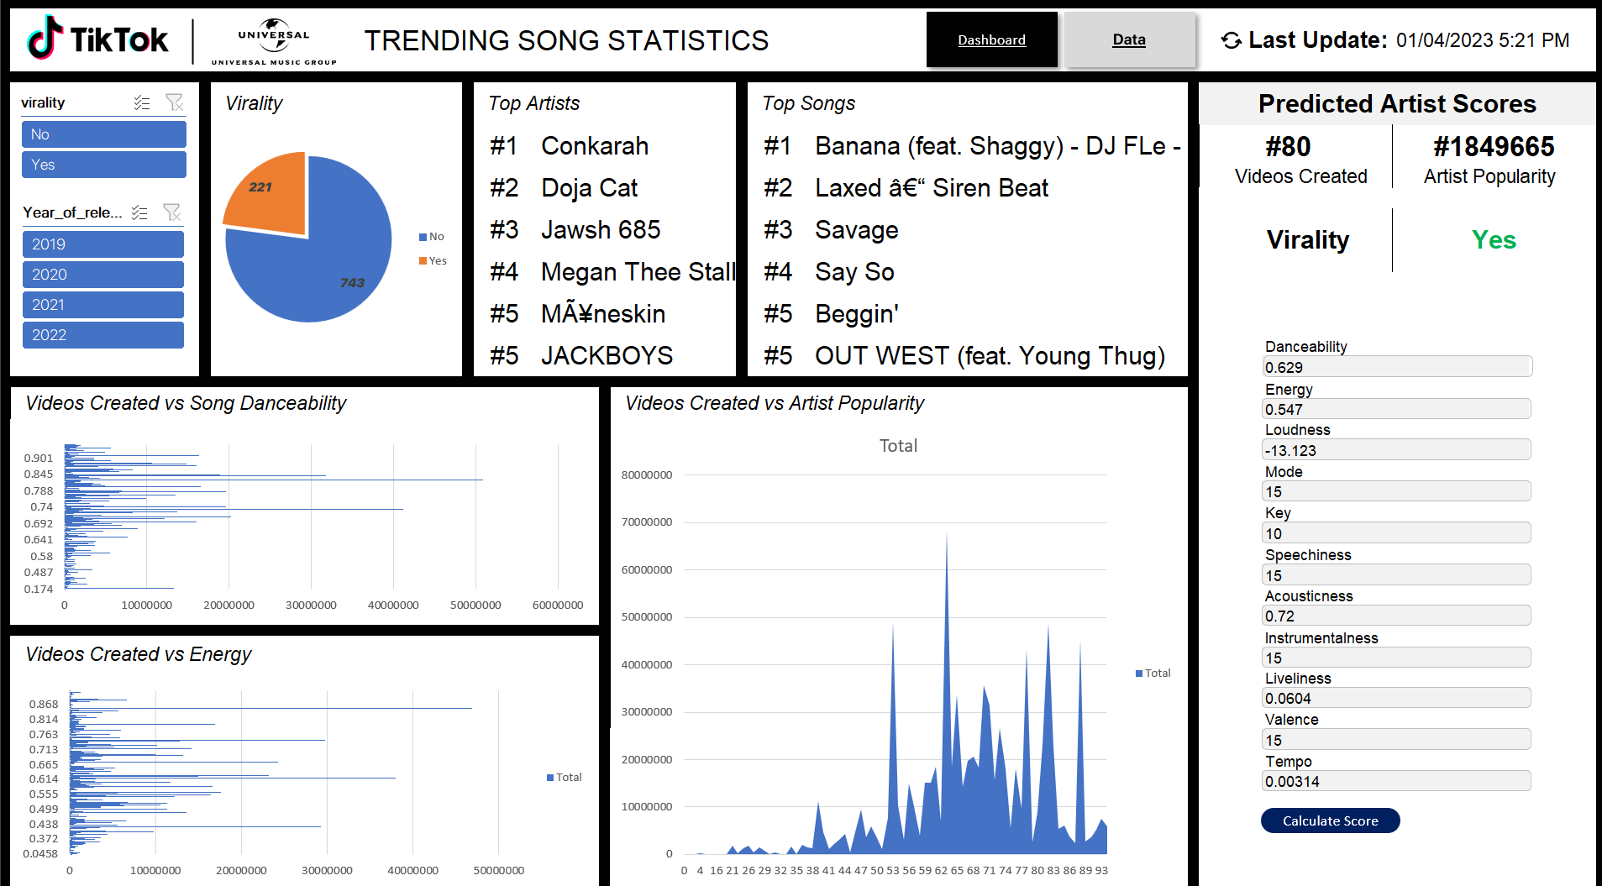
Introducing BeatScout: Helping UMG beat the competition and scout hidden gems in the music industry
BeatScout analyses a songs attributes to predict whether an artist's music can go viral on TikTok
Advait

Slide 43

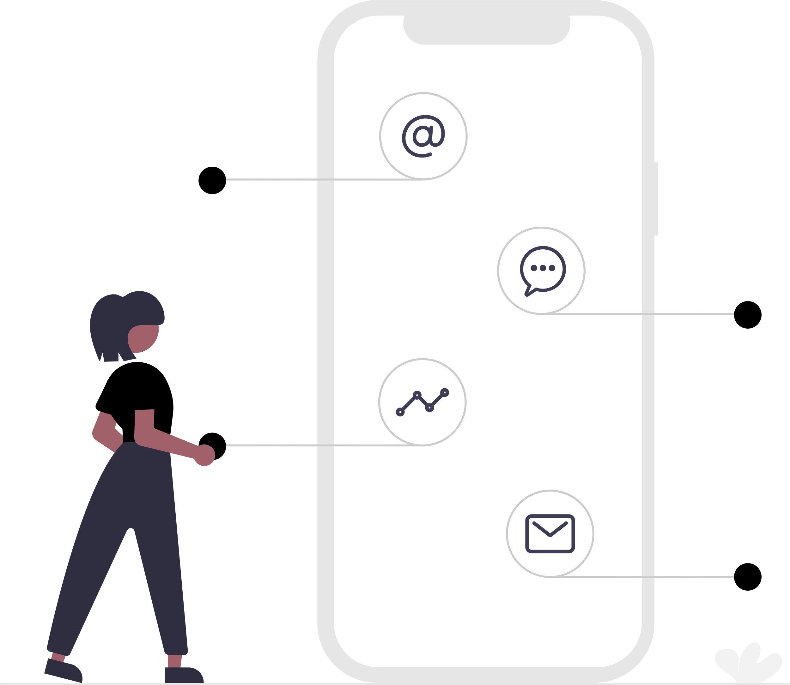

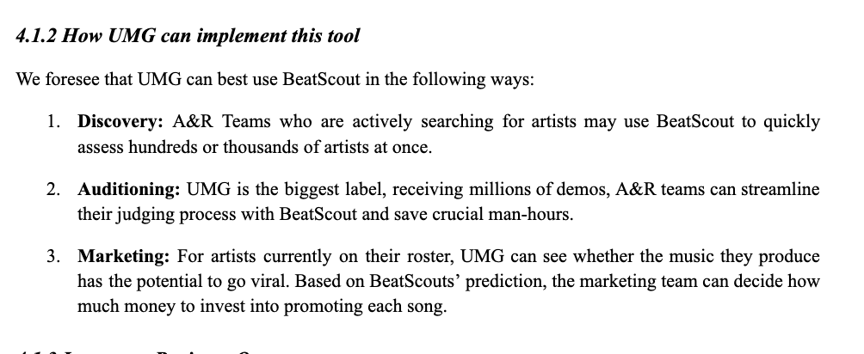
We can easily integrate BeatScout into UMGs workflow in a variety of ways
BeatScout can help A&R teams comb through hundreds or thousands of artists at once
Audition can be streamlined by relying on BeatScout to narrow down applications
For UMGs artists, BeatScout help Marketing Teams decide which songs need a promotional push
Discovery
Auditions
Marketing
UMG wants to recruit at least 10 new HipHop artists? No idea where to start?
Simply filter for 1000 HipHop songs with less than 10,000 streams and run them through BeatScout!
Advait

Slide 44
We can easily integrate BeatScout into UMGs workflow in a variety of ways
BeatScout can help A&R teams comb through hundreds or thousands of artists at once
Audition can be streamlined by relying on BeatScout to narrow down applications
For UMGs artists, BeatScout help Marketing Teams decide which songs need a promotional push
Discovery
Auditions
Marketing
Received 100 new Song Demos this week? No time to listen to all of them?
BeatScout can help you decide which songs are worth listening to first
Advait

Slide 45
We can easily integrate BeatScout into UMGs workflow in a variety of ways
BeatScout can help A&R teams comb through hundreds or thousands of artists at once
Audition can be streamlined by relying on BeatScout to narrow down applications
For UMGs artists, BeatScout help Marketing Teams decide which songs need a promotional push
Discovery
Auditions
Marketing
Your artist produced a few unorthodox songs? Don’t know whether they will catch on?
BeatScout can predict whether you need to do more promotions to push those songs to the public
Advait

Slide 46
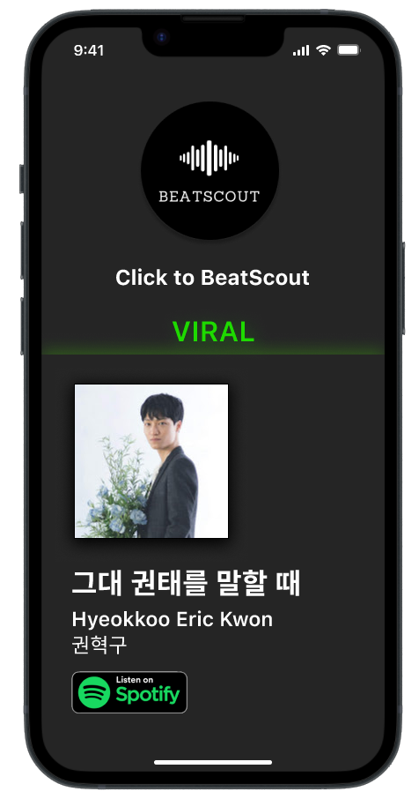


BeatScout is built to be convenient and accessible for busy executives
On his way to work, John can make a quick judgement on artists he is interested to sign
Advait

Slide 47
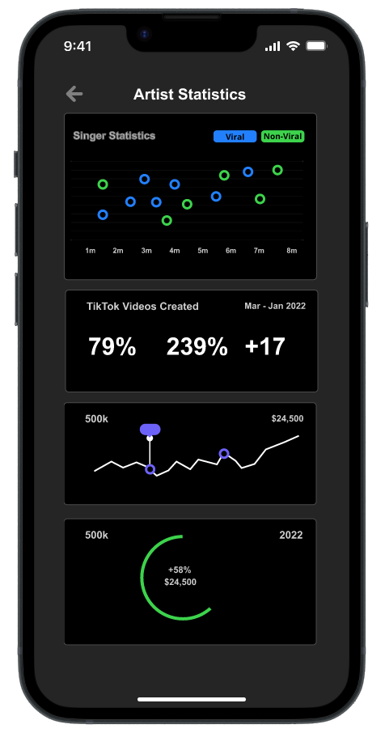
BeatScout is built to be convenient and accessible for busy executives
On his way to work, John can make a quick judgement on artists he is interested to sign
He can also view in-depth statistics conveniently on his phone
Advait

Slide 48
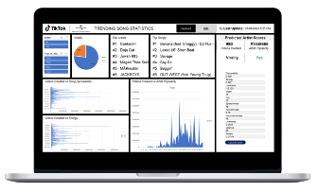

BeatScout is built to be convenient and accessible for busy executives
On his way to work, John can make a quick judgement on artists he is interested to sign
He can also view in-depth statistics conveniently on his phone
BeatScout will be ready on his laptop with the latest predictions for potential artists’ music
Advait

Slide 49
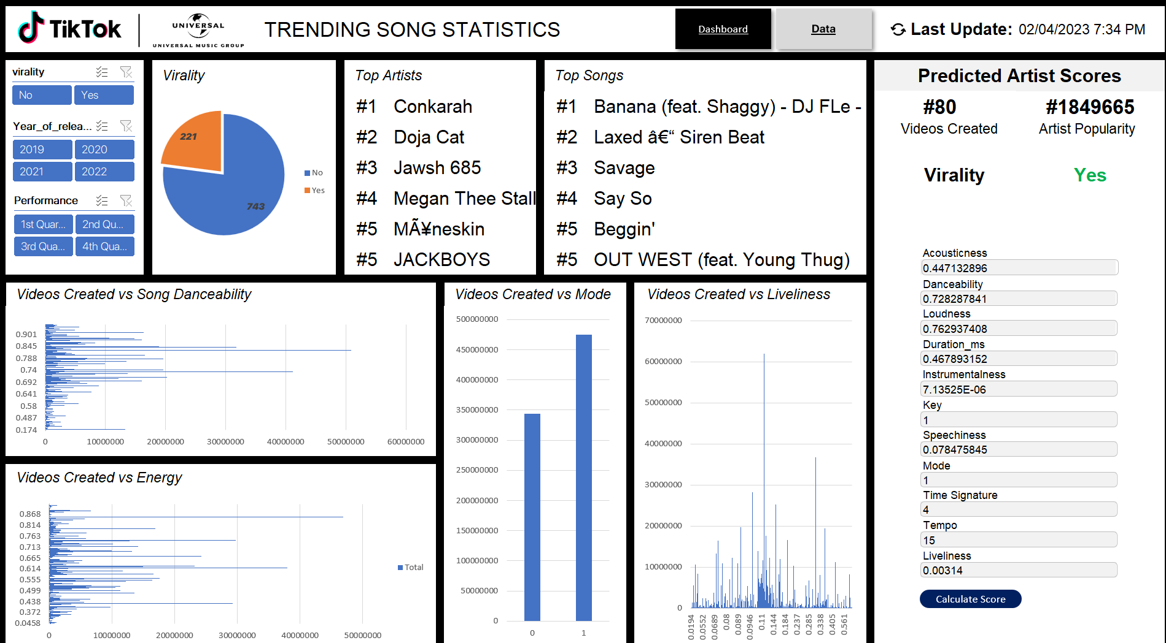
Live Demo
Wee Kiat

Slide 50
For A&R Executives: BeatScout provides rhyme and reason for the latest trends and saves a great deal of time
Deeper understanding of Viral Trends
The BeatScout dashboard gives John greater insight into why a song might have gone viral
Time & Energy Savings
John need not worry about missing out on talents, and can focus his energy on developing his roster of artists
John,
A&R Executive, UMG
Wee Kiat

Slide 51
BeatScout can bring about positive business outcomes in various areas
Saved Opportunity Costs
UMG can benefit from savings on labour and money that would have otherwise been lost on unsuccessful signings
Competitive Advantage
As the market leader, UMG can widen their competitive advantage, by making sure that they secure future stars before anyone else
Better Financial Performance
UMG does not have to worry about wasted resources on signings that did not work out.
Wee Kiat

Slide 52





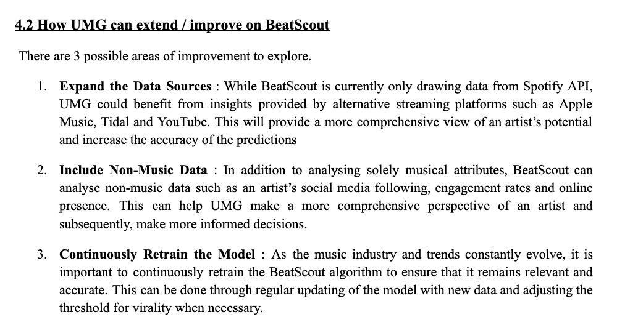
There is still scope for further extension and improvement on BeatScout
Expand Data Sources
This will provide a more comprehensive view of an artist’s potential and increase the accuracy of the predictions
Continuously Retrain the Model:
Music trends change fast, and the model must be updated to stay relevant
Include Non-Music Data:
{Followers, Likes, Engagement}
To gain popularity today, artists also rely on social media strategies
Wee Kiat

Slide 53
Thank You
Advait Bharat Deshpande
Foo Shi Jian
Ho Hui Yu
Neha Bhagat
Ng Wee Kiat
U2122619C
U2110071E
U2110926J
U2110235D
U2122504J
With our thanks to:

Slide 54
BeatScout Mockups

Slide 55
Data Dictionary
S/N | ATTRIBUTE | DESCRIPTION
1 | virality | Target Y variable where the song is viral or not.
2 | danceability | Danceability describes how suitable a track is for dancing based on a combination of musical elements including tempo, rhythm stability, beat strength, and overall regularity. A value of 0.0 is least danceable and 1.0 is most danceable.
3 | energy | Energy is a measure from 0.0 to 1.0 and represents a perceptual measure of intensity and activity. Typically, energetic tracks feel fast, loud, and noisy. For example, death metal has high energy, while a Bach prelude scores low on the scale. Perceptual features contributing to this attribute include dynamic range, perceived loudness, timbre, onset rate, and general entropy.
4 | loudness | The overall loudness of a track in decibels (dB). Loudness values are averaged across the entire track and are useful for comparing relative loudness of tracks. Loudness is the quality of a sound that is the primary psychological correlate of physical strength (amplitude). Values typically range between -60 and 0 db.
5 | mode | Mode indicates the modality (major or minor) of a track, the type of scale from which its melodic content is derived. Major is represented by 1 and minor is 0.
6 | key | The key the track is in. Integers map to pitches using standard Pitch Class notation. E.g. 0 = C, 1 = C♯/D♭, 2 = D, and so on. If no key was detected, the value is -1.
7 | speechiness | Speechiness detects the presence of spoken words in a track. The more exclusively speech-like the recording (e.g. talk show, audio book, poetry), the closer to 1.0 the attribute value. Values above 0.66 describe tracks that are probably made entirely of spoken words. Values between 0.33 and 0.66 describe tracks that may contain both music and speech, either in sections or layered, including such cases as rap music. Values below 0.33 most likely represent music and other non-speech-like tracks.
8 | acousticness | A confidence measure from 0.0 to 1.0 of whether the track is acoustic. 1.0 represents high confidence the track is acoustic.
9 | instrumentalness | Predicts whether a track contains no vocals. "Ooh" and "aah" sounds are treated as instrumental in this context. Rap or spoken word tracks are clearly "vocal". The closer the instrumentalness value is to 1.0, the greater likelihood the track contains no vocal content. Values above 0.5 are intended to represent instrumental tracks, but confidence is higher as the value approaches 1.0.
10 | liveness | Detects the presence of an audience in the recording. Higher liveness values represent an increased probability that the track was performed live. A value above 0.8 provides strong likelihood that the track is live.
11 | valence | A measure from 0.0 to 1.0 describing the musical positiveness conveyed by a track. Tracks with high valence sound more positive (e.g. happy, cheerful, euphoric), while tracks with low valence sound more negative (e.g. sad, depressed, angry).
12 | tempo | The overall estimated tempo of a track in beats per minute (BPM). In musical terminology, tempo is the speed or pace of a given piece and derives directly from the average beat duration.
13 | time_signature | An estimated time signature. The time signature (meter) is a notational convention to specify how many beats are in each bar (or measure). The time signature ranges from 3 to 7 indicating time signatures of "3/4", to "7/4".
14 | duration_ms | The duration of the track in milliseconds.

